Slide 1




S.No. | Post | Name of the Student | Class | House
1. | HEAD BOY | ABHIMANYU RAJORA | V-C | JAWAHAR
2. | HEAD GIRL | JANVI SHARMA | V-B | SHASTRI
3. | VICE-HEAD BOY | KAAYAN | IV-C | SHASTRI
4. | VICE-HEAD GIRL | ANICA ROHILLA | IV-E | SHASTRI
5. | SPORTS SECRETARY (B) | HITANSH | V-A | GANDHI
6. | SPORTS SECRETARY (G) | OMAANA GURUNG | V-B | SHASTRI
7. | LITERARY SECRETARY | ROOHANIKA MAURYA | V-A | TAGORE
8. | CHIEF LANGUAGE PREFECT | KUSHAGRA BHATT | V-A | SUBHASH
9. | CULTURAL SECRETARY | NYRA SETHI | V-A | SHASTRI
2024-25
A
bility…Motivation…
Attitu
de…

Slide 2



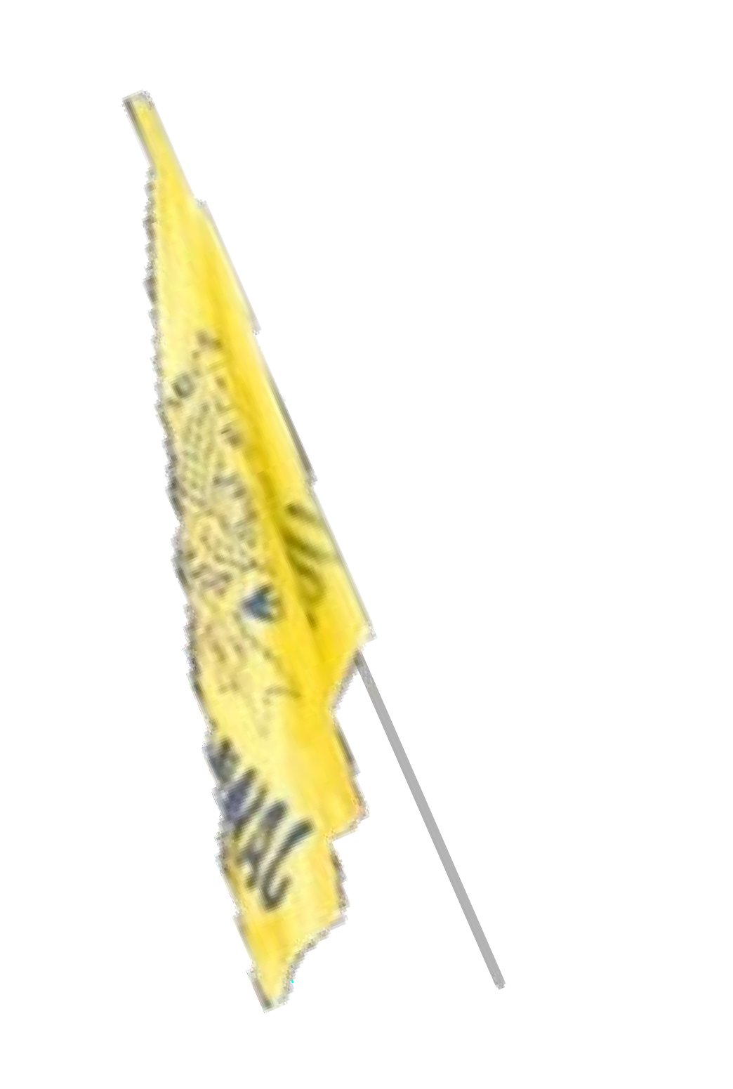

2024-25
GANDHI HOUSE
S.No. | POST | NAME OF THE STUDENT | CLASS
1. | HOUSE CAPTAIN | DIYA | V-C
2. | HOUSE VICE CAPTAIN | NUPUR AGGARWAL | IV-D
3. | SPORTS CAPTAIN | AKUL SHARMA | V-C
4. | Environment Beautification Prefect | JAI YADAV | V-B
5. | HOUSE PREFECT | PAVANI GOEL SAANVI GUPTA PIHU SEHAJ KAUR | IV-A V-A V-D IV-A
JAWAHAR HOUSE
S.No. | POST | NAME OF THE STUDENT | CLASS
1. | HOUSE CAPTAIN | UTKARSH TANWAR | V-B
2. | HOUSE VICE CAPTAIN | AMAYRA CHAWLA | IV-C
3. | SPORTS CAPTAIN | HARSHIT | V-A
4. | Environment Beautification Prefect | RIYA | V-E
5. | HOUSE PREFECT | YUG KUMAR VIKRAM VAIBHAV MOLPARIYA MISHKA GUPTA | IV-E IV-C V-E V-D

Slide 3
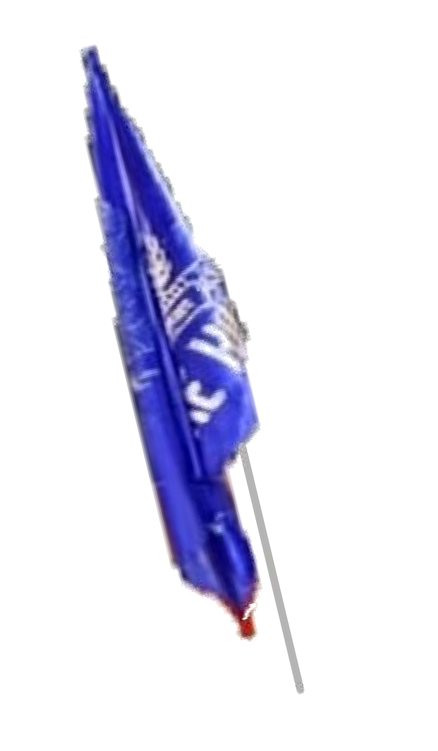
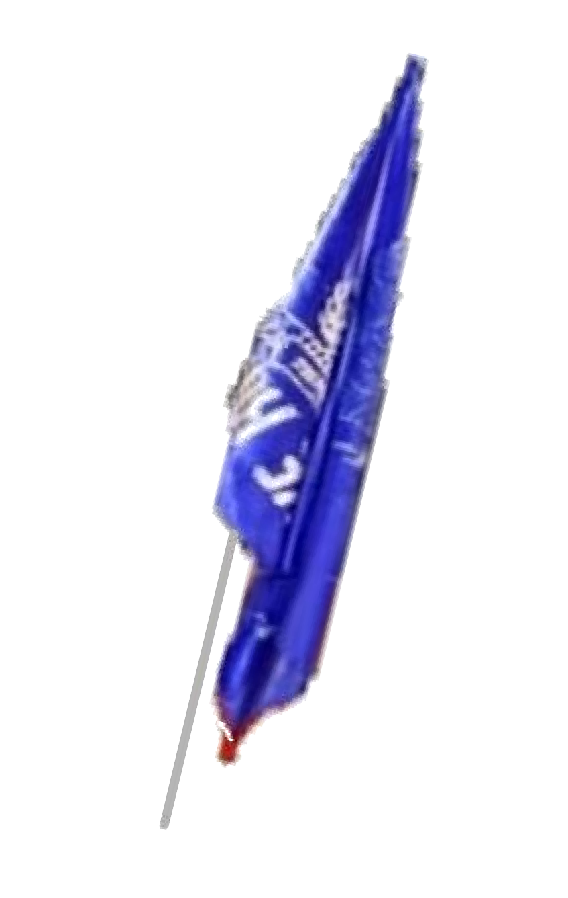
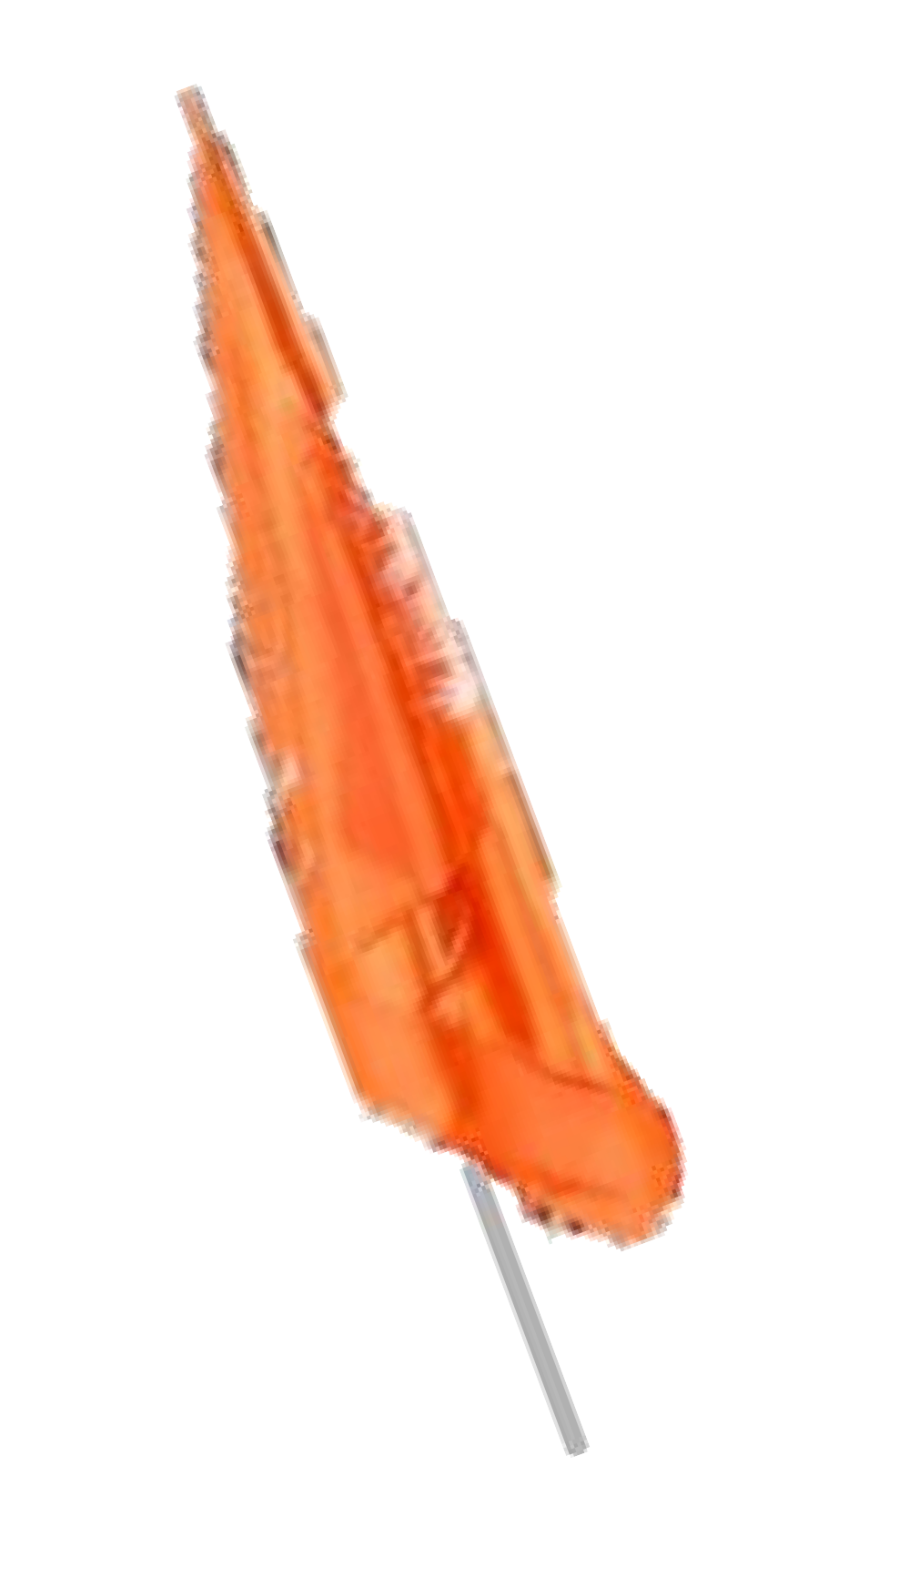

2024-25
TAGORE HOUSE
S.No. | POST | NAME OF THE STUDENT | CLASS
1. | HOUSE CAPTAIN | DAKSHITA SHARMA | V-E
2. | HOUSE VICE CAPTAIN | MEDHANSH MITTAL | IV-B
3. | SPORTS CAPTAIN | KANISHA GOYAL | V-C
4. | Environment Beautification Prefect | ARIHANT JAIN | V-E
5. | HOUSE PREFECT | OORJA GAAT AARAV SAINI PRIYANSH GROVER BHUVI SHARMA | IV-E V-C V-E IV-D
SUBHASH HOUSE
S.No. | POST | NAME OF THE STUDENT | CLASS
1. | HOUSE CAPTAIN | KARTIK MITTAL | V-C
2. | HOUSE VICE CAPTAIN | SHRIKIRTI GUPTA | IV-A
3. | SPORTS CAPTAIN | PRAVEER SAPRA | V-D
4. | Environment Beautification Prefect | MISHIKA | V-E
5. | HOUSE PREFECT | MITASHI RAYANSH DANG JANISHA SANVI MALIK | V-A V-E V-C V-C

Slide 4




2024-25
PATEL HOUSE
S.No. | POST | NAME OF THE STUDENT | C LASS
1. | HOUSE CAPTAIN | SIDDHANT LAMBA | V-C
2. | HOUSE VICE CAPTAIN | FATIMAH | IV-A
3. | SPORTS CAPTAIN | DIVYANSHI CHAWLA | V-B
4. | Environment Beautification Prefect | JASMINE KOHLI | V-C
5. | HOUSE PREFECT | NITYA RANA NISHTHA AVIKA DHAANI MAHAWAR | V-E IV-E V-A IV-A
SHASTRI HOUSE
S.No. | POST | NAME OF THE ST U DENT | C LASS
1. | HOUSE CAPTAIN | CHITRAKSHI | V-E
2. | HOUSE VICE CAPTAIN | JIANA LAMBA | IV-A
3. | SPORTS CAPTAIN | SAANCHI ARYA | V-B
4. | Environment Beautification Prefect | AARADHYA | V-D
5. | HOUSE PREFECT | NYRA CHAUHAN MRIDUL HANYA SHARMA ANIKA VERMA | IV-C V-C V-D IV-C

